Slide 1
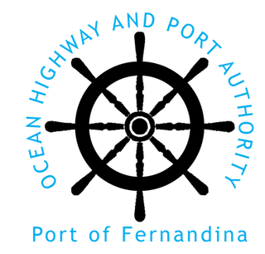
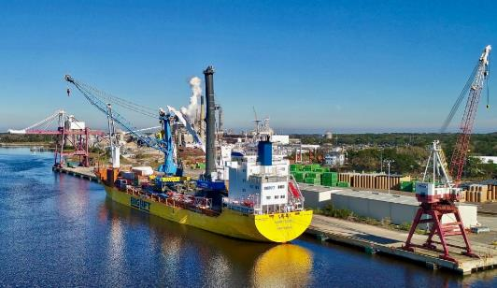
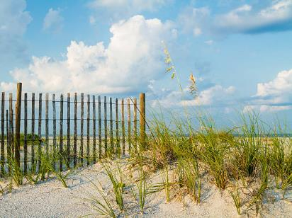
PORT OF FERNANDINA
Port Resiliency Action Plan Workshop
July 12, 2023 - 5:00 to 6:00 PM

Slide 2
Meeting Agenda
Welcome and Introduction
Project Overview, Project Manager, and Project Consultant
What is Resilience
What Resilience Is and Is Not
Related Federal and State Efforts
What are Shocks and Stresses
Project Overview
Scope Overview
Schedule Review Completed, Ongoing, and Upcoming Tasks
Port Terminal Existing Conditions
Initial Impacts Assessment
On-going Gap Analysis and Vulnerability Assessment
On-Going Coordination
State and City Plans Coordination
Other Stakeholders and Potential Partners
Next Steps – Meetings with Federal, State, and Local Agencies

Slide 3
Welcome and Introduction
Project Overview
Provide FDOT and the Port a comprehensive resource describing existing conditions, documenting impacts, determining vulnerabilities, providing infrastructure mitigation plan, intergovernmental coordination, and opportunities for project funding and implementation.

Slide 4
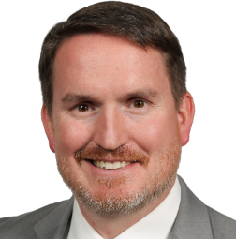
Welcome and Introduction
Project Manager
JIMMY MCDONALD
Senior Freight and Port Planner
22 Years Planning Experience
jamcdonald@hntb.com

Slide 5
Welcome and Introduction
Project Consultant
Ranked 12th of Top 500 Design Firms by Engineering News Record
https://www.hntb.com/

Slide 6
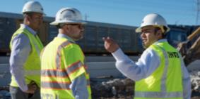
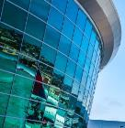
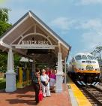
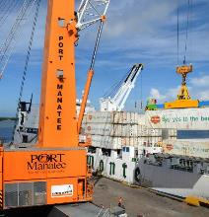
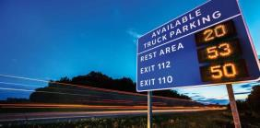
Welcome and Introduction
MARKETS AND SERVICES
Aviation
Highways
Ports & Logistics
Rail and Transit
Waterways
Bridges
Architecture
Construction
Design-build
Planning
Environment
Program Management
Intelligent Transportation Systems
Technology
Tolls
Tunnels

Slide 7
Welcome and Introduction
80 Offices
7 Divisions
9 Florida Offices

Slide 8
What is Resilience?
“The capacity to withstand or recover from Shocks and Stresses”
Resilience is not just drainage
Resilience is not just preparing for natural disasters and sea level rise
Resilience is definitely NOT the same as Sustainability!
Notes:
Things like Sustainability, Green Infrastructure, Low Impact Development, can be a component that contributes to Resilience, but they are not synonymous with Resilience

Slide 9
What are Shocks and Stresses
Shocks
Stresses
Think “events”
Hurricanes
Storm Surge
Tornados
Earthquakes
Fires
Sudden Economic/Societal Events
Think “chronic conditions”
Sea Level Rise
Repeated Flooding
King Tide
Climate Change
Degrading Economic/Societal Conditions

Slide 10
What Resilience IS and IS NOT
IS
IS NOT
Considering the project, and assets within the project, as part of a whole transportation system
Considering the people and communities both impacted and benefited
Considering Risk
Vulnerability, Exposure, Sensitivity
Considering Stakeholder and Resources
Building a like-for-like project and calling it resilience
Overbuilding for the sake of overbuilding
Making one feature super-resilient without considering the rest of the system
Focusing on hardening an asset without thinking about the people and communities that are impacted and benefited

Slide 11
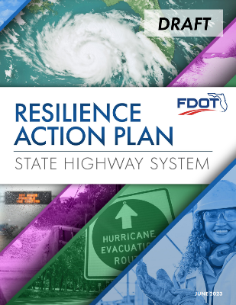
Related Federal and State Efforts
Federal Resiliency Efforts
Infrastructure Investment and Jobs Act (IIJA) (Public Law 117-58)
Promoting Resilient Operations for Transformative, Efficient, and Cost-Saving Transportation (PROTECT) Act
PROTECT Formula $7.3 Billion and Discretionary $1.4 Billion Annual Federal Funding
FDOT Long-term Resiliency Commitment
Created Office of Resiliency
Statewide Resiliency Coordinator – Jennifer Carver
Enacted Policy – April 27, 2020 (Topic No:. 000-525-053)
Prepared Resiliency Action Plan (RAP) 2023

Slide 12
FDOT COMPASS
COMMUNITIES
SAFETY
RESILIENCY
ROBUST SUPPLY CHAIN
Notes:
Resilience is so important to FDOT that it is a part of FDOT’s compass; which are focus areas that navigate Florida’s transportation system
4 of the 6 items that drive FDOT are met by preparing a resiliency Plan for the Port
Safety, Communities, Resiliency, and Robust Supply Chains

Slide 13
Project Overview
Scope Overview
Kick-off and Meetings with Client and Stakeholder – On-going
Task 1 – Impacts Assessment – Near Draft Complete
Task 2 – Gap Analysis and Vulnerability Assessment - Underway
Task 3 – Infrastructure Mitigation Plan – Initiated
Task 4 – Intergovernmental Coordination - Underway
Task 5 – Plan Implementation – Underway

Slide 14
Project Overview
Schedule Review
Completed, On-going, and Upcoming Tasks

Slide 15
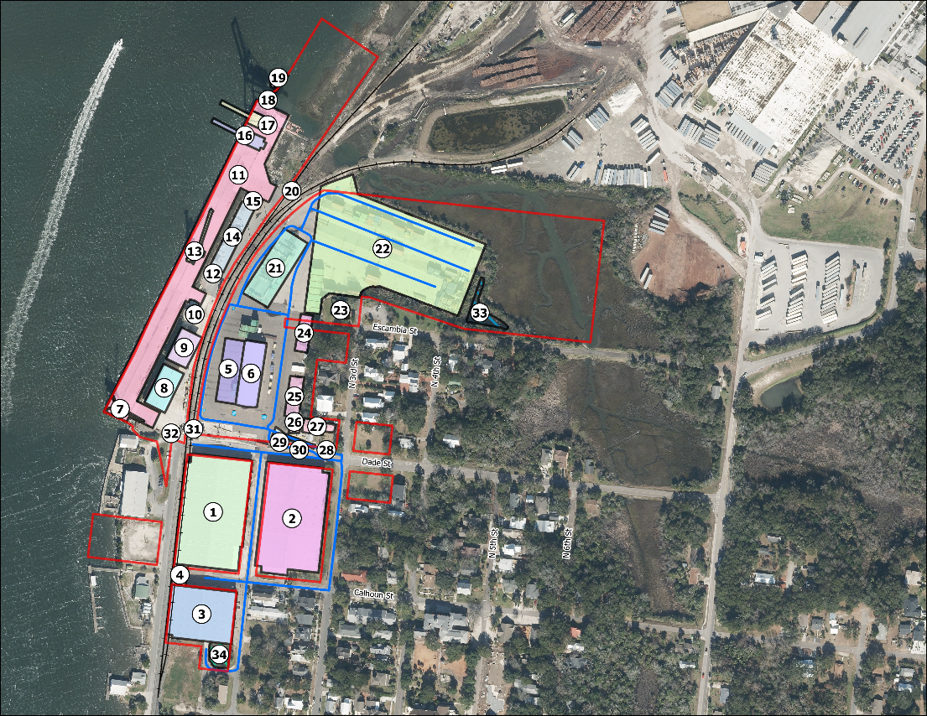
Port Terminal Existing Conditions

Slide 16
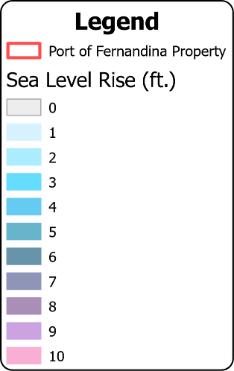
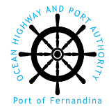
Initial Impacts Assessment
Sea Level Rise

Slide 17
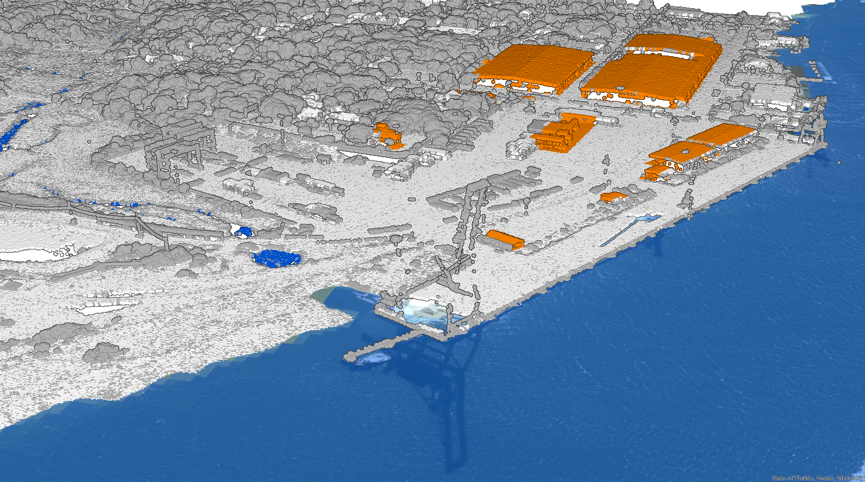
Initial Impacts Assessment
NOAA Sea Level Rise
0 ft

Slide 18
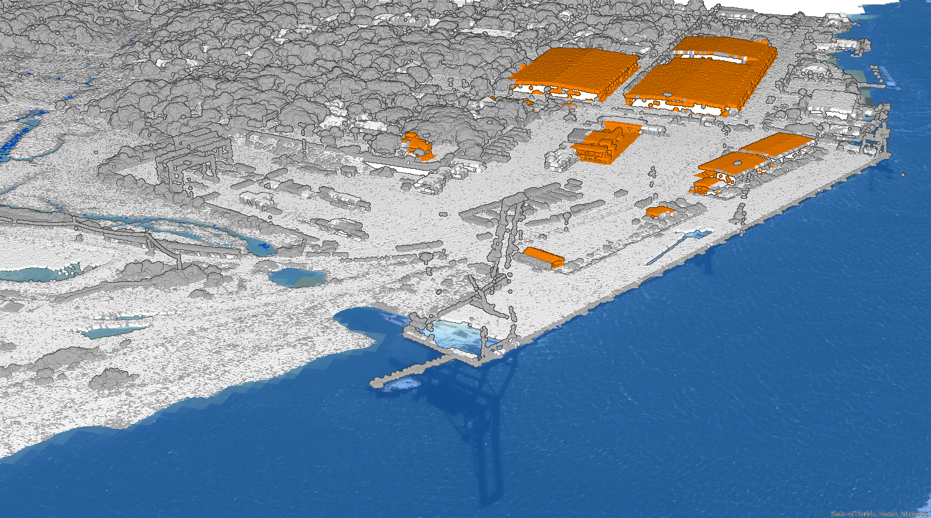
Initial Impacts Assessment
NOAA Sea Level Rise
1 ft

Slide 19
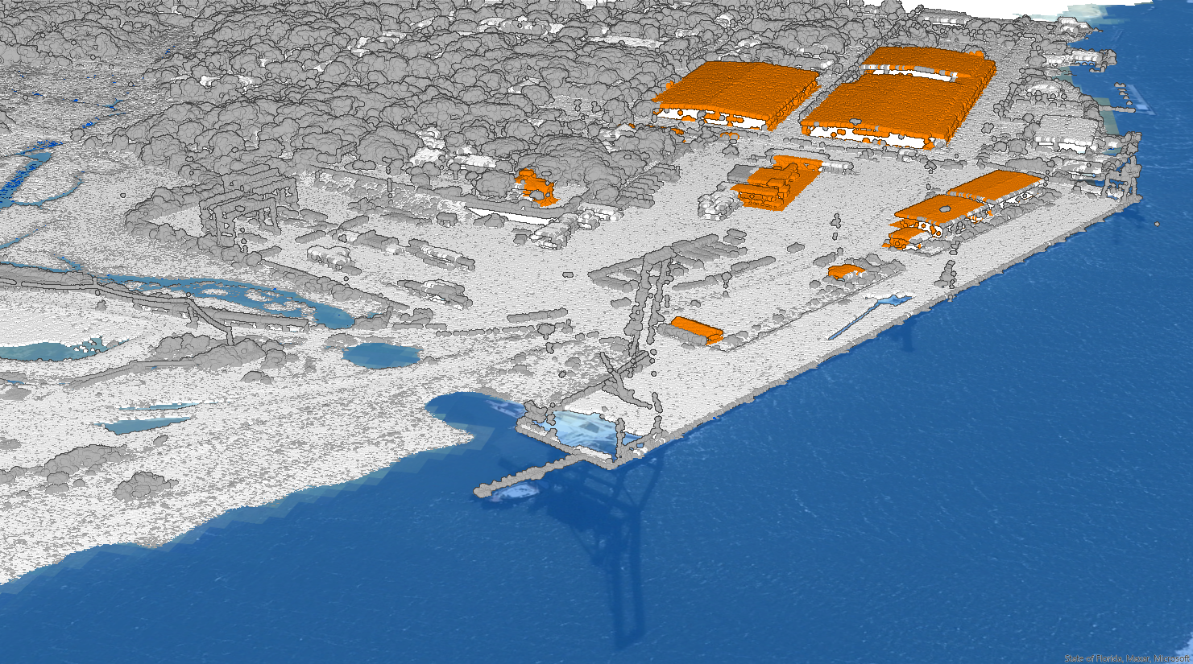
Initial Impacts Assessment
Initial Impacts Assessment
NOAA Sea Level Rise
2 ft

Slide 20
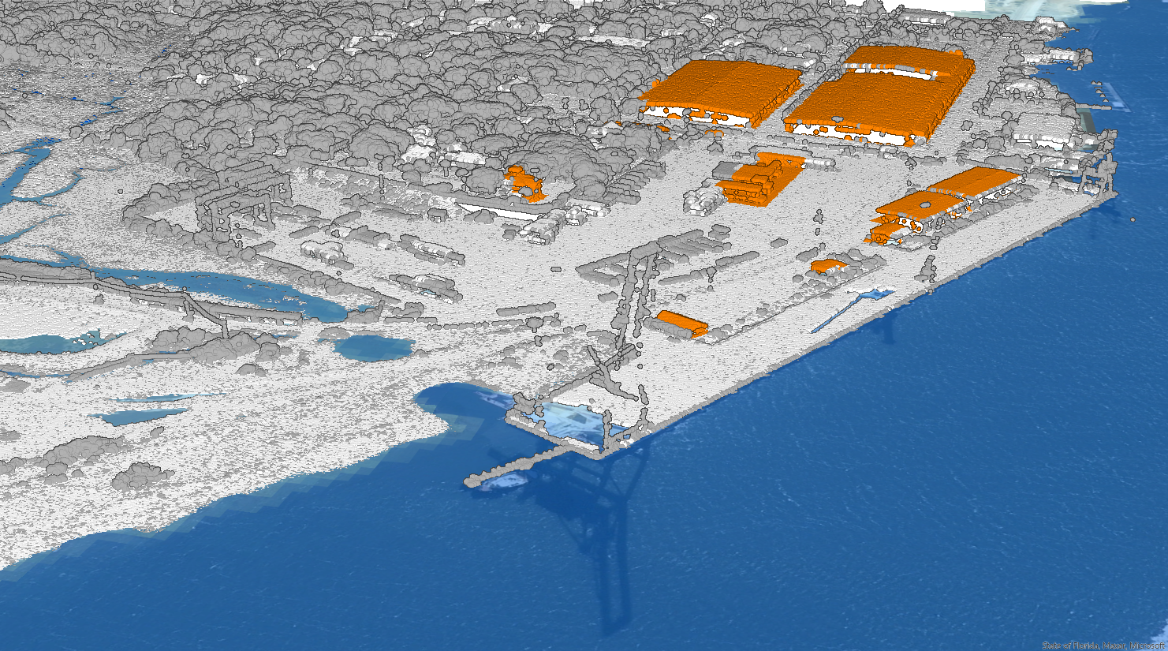
Initial Impacts Assessment
Initial Impacts Assessment
NOAA Sea Level Rise
3 ft

Slide 21
Initial Impacts Assessment
Initial Impacts Assessment
NOAA Sea Level Rise
4 ft

Slide 22
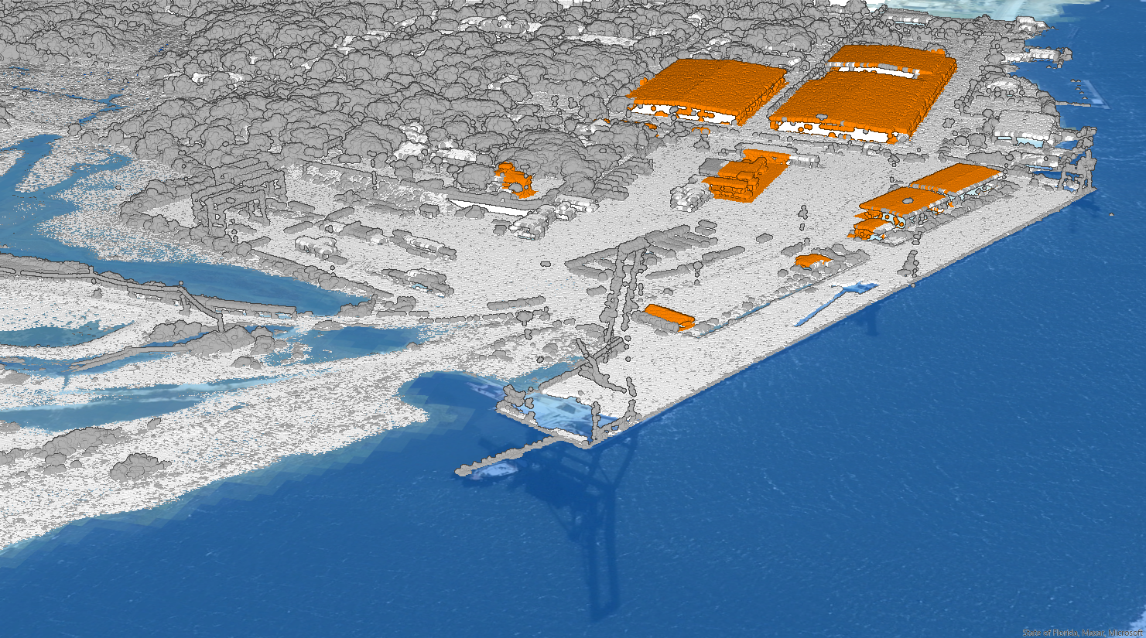
Initial Impacts Assessment
Initial Impacts Assessment
NOAA Sea Level Rise
5 ft

Slide 23
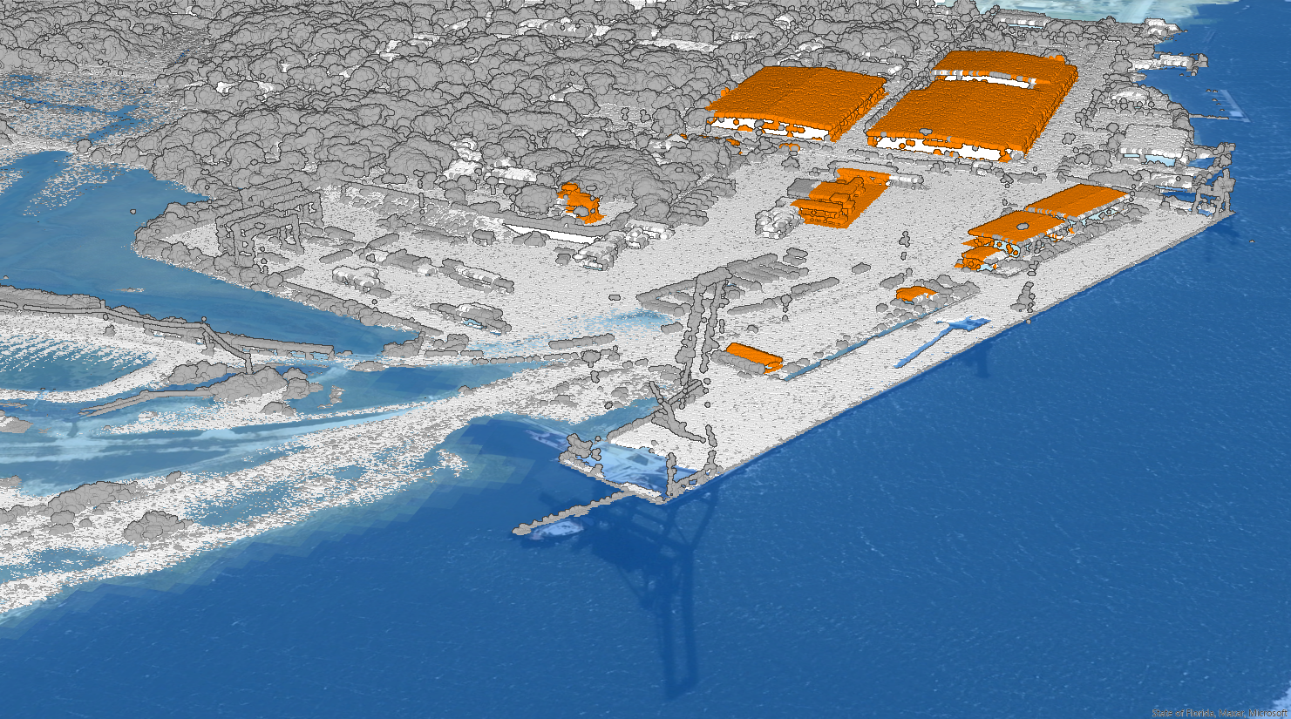
Initial Impacts Assessment
Initial Impacts Assessment
NOAA Sea Level Rise
6 ft

Slide 24
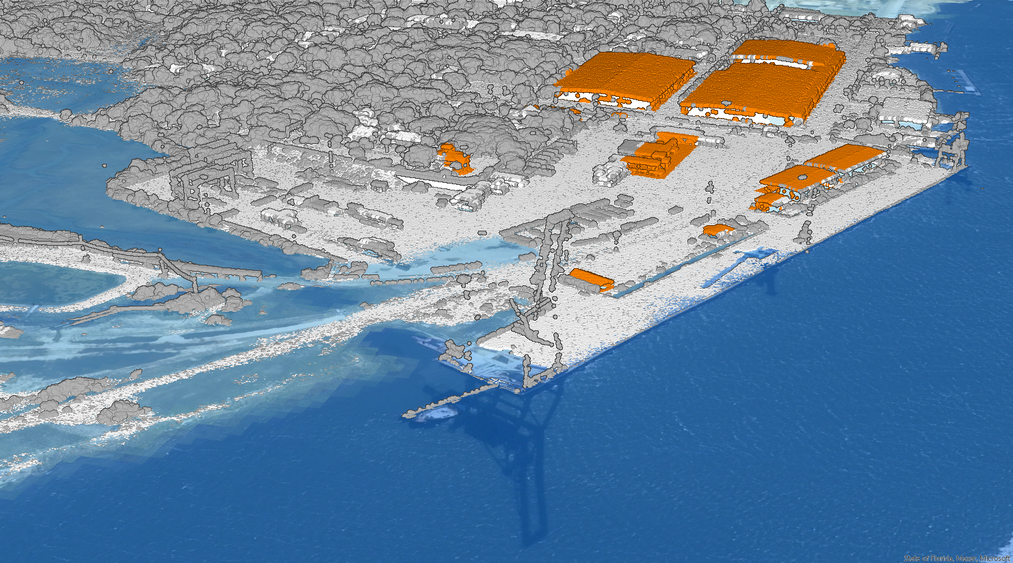
Initial Impacts Assessment
Initial Impacts Assessment
NOAA Sea Level Rise
7 ft

Slide 25
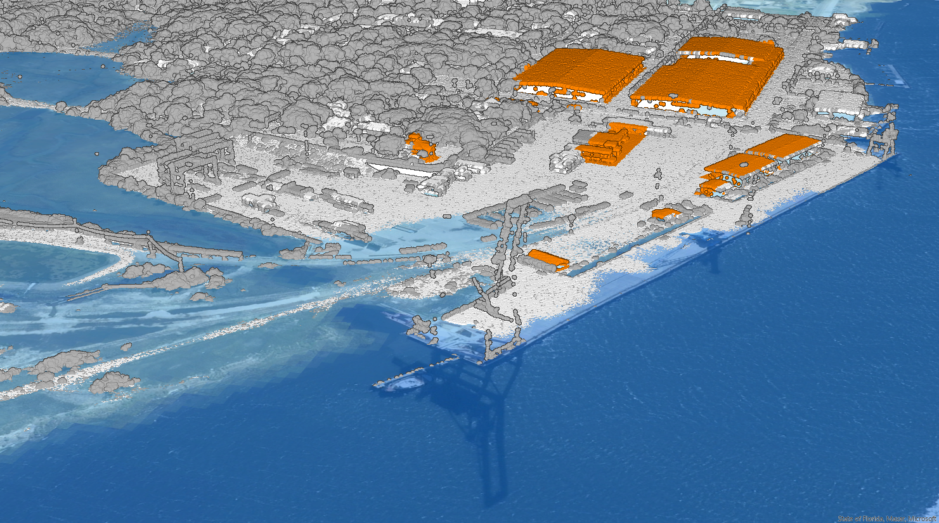
Initial Impacts Assessment
Initial Impacts Assessment
NOAA Sea Level Rise
8 ft

Slide 26
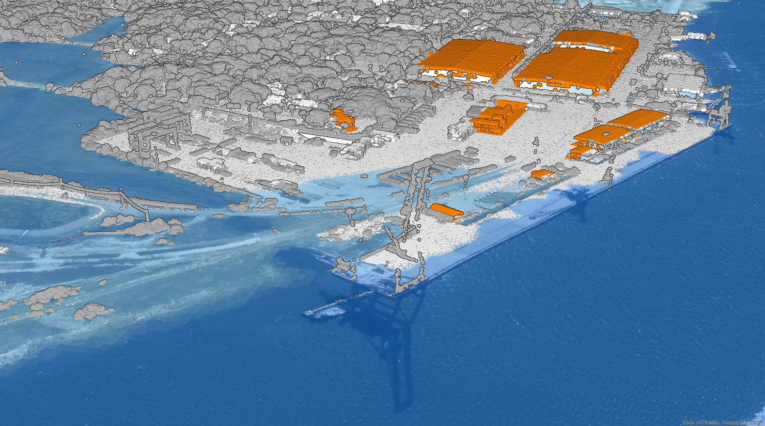
Initial Impacts Assessment
Initial Impacts Assessment
NOAA Sea Level Rise
9 ft

Slide 27
Initial Impacts Assessment
Initial Impacts Assessment
NOAA Sea Level Rise
10 ft

Slide 28
Discussion on Impacts with Key Stakeholders
On-going Activities and Coordination:
City of Fernandina Beach Resiliency Plan Coordination
FDOT Coordination and Resiliency Action Plan (RAP)
Port-wide Vulnerability Assessment and Gaps Analysis
Railroad Impacts – G&W First Coast Railroad (FCRD)
Mill Site Impacts
Next Steps:
Meetings with Federal, State, and Local Agencies
Work on Infrastructure Mitigation Plan

Slide 29
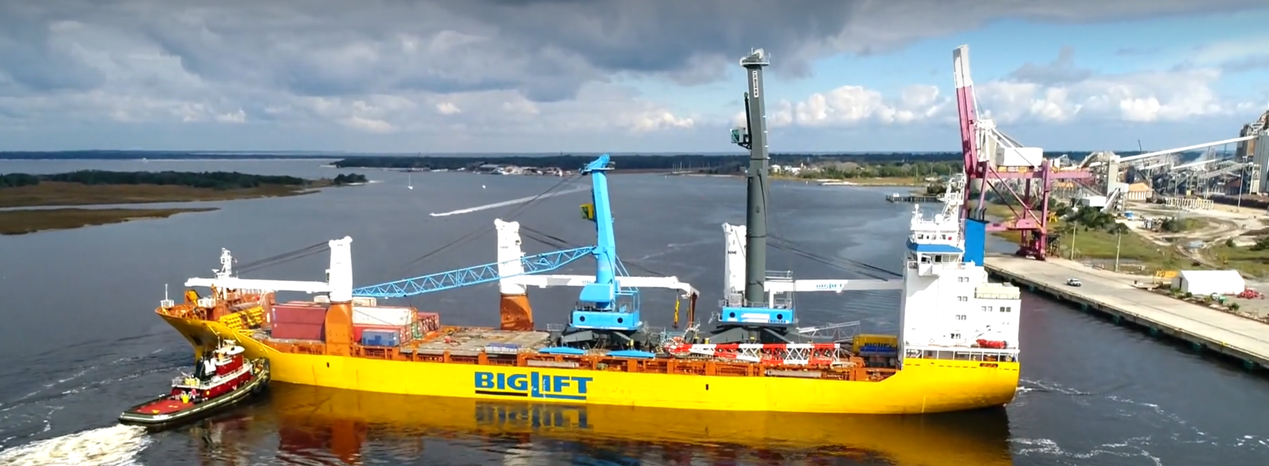
Thank You - Questions

